Slide 1

Product Management
Certification Program
Industry Project - I
Notes:
© Copyright UpGrad Education Pvt. Ltd. All rights reserved

Slide 2
Submission Guidelines
After completing all the parts of the project, you will have to submit your responses in the following manner.
Submit the following parts of the project in this “Presentation’’ file
Part 1 - Understanding the market
Part 2 - User research
Part 5 - MVP Creation
Part 6 - Sketching
Part 7 - Wireframing & Prototyping
Submit the following part of the project in the template document provided on the platform.
Part 3 - Business Model Canvas
Part 4 - Product Artifacts
User Persona
User Journey Map
Note: Finally you have to add this Presentation & other submission documents in a ZIP folder and upload it in the submission section on the platform. More details in slides to follow
Notes:
© Copyright UpGrad Education Pvt. Ltd. All rights reserved

Slide 3
Part 1: Understanding the Market
Notes:
© Copyright UpGrad Education Pvt. Ltd. All rights reserved

Slide 4
Target Market Identification
Food delivery is not a new concept. People are used to order food by making phone call to the restaurant of their choice. The convenience of ordering food from multiple restaurants with just few clicks on their smart phone is a delight for many and this led and is continuing to lead to the astronomical rise of the industry.
This growth is mainly powered by the millennials in urban & semi urban areas.
It was estimated by Frost & Sullivan that the Total Online Food Delivery Market is around $ 100B and is expected to grow to $ 200B by 2025.
In India, our Serviceable Market, the market in 2020 is worth around $ 10B and is estimated to grow to $ 12B by 2025.
Assuming, we can capture 20% of the current market by 2025, we can obtain a market of $ 2.4B.
Notes:
© Copyright UpGrad Education Pvt. Ltd. All rights reserved

Slide 5
Porter's Five Forces Analysis
The threat of New Entrants:
Since the Food delivery market in India is facing consolidation, the threat of new entrants is reduced to an extent. The overall rating could be for this force could below. Major players operating in this segment are Swiggy & Zomato holding 75-80% market share. Swiggy was leading with the number of deliveries per day, followed by Zomato. Moreover, the acquisition of Ubereats by Zomato has turned this game further, consolidating the number of players in this trade.
The threat of substitution:
With the availability of applications of all the food delivery chains on Handheld, the threat of substitution becomes very high. Since these platforms are too savvy to be used & equivalent available with the users on a mobile phone, switching among the choices is very easy.
Since an individual has a choice of scrolling the options among the desired dish, it is very common to check it on more than one application. Available brands, flavors & portion sizes, help giving choices to the consumers. One can look at two or more applications to hunt the availability of a favorite dish like a ‘Biryani’. Usually, popular dishes have multiple brands in any city & work as a substitute among themselves. Hence, swapping applications to choose from brands becomes one of the important reasons for Substitution.
Notes:
© Copyright UpGrad Education Pvt. Ltd. All rights reserved

Slide 6
Porter's Five Forces Analysis
Bargaining power of suppliers:
The bargaining power of suppliers can still be called as Moderate due to the supply chain challenges. Suppliers operating across the nation are critical for the deal. The customer expects a similar experience for any dish, he orders, irrespective of the geographies. Though it is easier to get these raw materials in Tier One cities, getting the same in further tiers, sometimes becomes difficult.
Direct supplies have challenges of logistics feasibility to remote locations due to lower volume requirements. Shipping products in part loads can affect the quality of the product, due to multiple handing & higher transit time.
Bargaining power of the Buyer:
Linked to the threat of Substitution, the bargaining power of the customer for the food delivery industry is high.
a. Number of buyers relative to suppliers: If the number of buyers is small relative to that of suppliers, the buyer’s power will be stronger. Still, with the higher number of suppliers available, buyer power is higher.
b. Dependence of a buyer’s purchase on a supplier: If a buyer can get similar products/services from other suppliers, buyers depend less on a supplier. Therefore, the power of the buyer would be greater. Since the services offered by these players are similar, the dependency on a supplier is minimal, boosting the bargaining power of the buyer.
Notes:
© Copyright UpGrad Education Pvt. Ltd. All rights reserved

Slide 7
Porter's Five Forces Analysis
c. Switching costs: If there are not many alternative suppliers available, the cost of switching is high. Therefore, buyer power would below. There is no cost of switching from one supplier to another, as, both the good aggregators are available on a single click on the handheld.
d. Backward Integration: If the buyer can integrate or merge suppliers, the buyer has greater bargaining power over the existing suppliers. No such parameters affect the food delivery industry.
Competition Rivalry:
The acquisition of Ubereats by Zomato still has reduced the number of players, defining Competition Rivalry to Moderate.
According to stats, there is an increase of more than 100 percent in online food orders in the past 3 years. Referring to the 5 forces, things are different at the ground level. As per Zomato’s released annual income stats, few things were very surprising in that report. According to Zomato, their revenue for FY2019 is $206 million. Zomato recorded the highest revenue in 2019 as compared to its revenues of $68 million last year. But Zomato had spent on marketing in FY2019 and it is $500 million. According to Zomato, they are losing Rs 25 per delivery20. So, one needs to decide, Was Zomato profitable in FY2019. This invites a need to understand how to arrive at a sustainable Business Strategy.
Notes:
© Copyright UpGrad Education Pvt. Ltd. All rights reserved

Slide 8
Porter's Five Forces Summary
Low threat of entry
Market is consolidating
2 players with maximum market share discouraging new entrants
Bargaining power is high
Promos, discounts offered by competitors provides a lot of cheaper alternatives to the customers
Bargaining power might reduce in future if more consolidation happens
Competitive rivalry is very high in India
With huge market potential more & more domestic & international players are opening shop
Buying power of suppliers is a double edged sword in this industry
More & more restaurants relying on online sites to increase sales has reduced their buying power
Online portals trying to ensure consistent supply where raw materials prices change frequently increases the buying power of the suppliers
Threat of substitution is high
Easy availability of products & their alternatives increases the threat of substitution
Distinguishing products from the compe
Notes:
© Copyright UpGrad Education Pvt. Ltd. All rights reserved

Slide 9
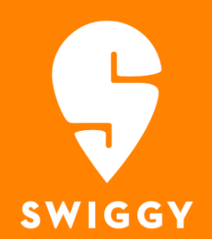


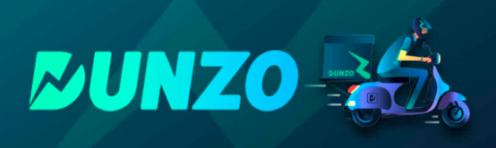
Competitor Analysis
Major Food Tech Players in India:
Swiggy (Direct Competitor)
Zomato (Direct Competitor)
FreshMenu (Direct Competitor)
Food Panda (closed)
Uber Eats (Acquired by Zomato)
Dunzo (Indirect Competitor)
Notes:
© Copyright UpGrad Education Pvt. Ltd. All rights reserved

Slide 10
Competitor’s Background

Slide 11
 | Swiggy | Zomato
Mission | Change the way India eats | To provide better food for everyone
Goal | To disrupt the kitchen at home and make the delivery service a viable option for an everyday food need | Connecting customers to restaurants and ensure customers have the best experience at any restaurant found on the platform
Strategy | Making Hyperlocal product deliveries | A platform that brings restaurants, suppliers, consumers, food suppliers, and logistics partners together
Current Employees | 2,00,000+ | 5000+
Current Value | $3.6 billion | $3.25 billion
Latest Funding Round | Their latest funding was raised on Apr 6, 2020 from a Series I round of $43M. | Their latest funding was raised on Sep 10, 2020 from a Series J round.
Total Funding Raised | Swiggy has raised a total of $1.6B in funding over 12 rounds. | Zomato has raised a total of $1.1B in funding over 17 rounds.

Slide 12
 | Swiggy | Zomato
Revenue | Rs 1128 cr (2019),Rs 442 cr (2018) | Rs 1397 cr (2019),Rs 442 cr (2018)
CEO | Sriharsha Majety- He is a former Co-Founder of Bundl and Associate at Nomura International. Mr. Majety graduated received a B.E. in Electrical and Electronics and an M.Sc. in Physics at BITS, Pilani. | Deepinder Goyal –Prior to starting Zomato, Deepinder worked as a management consultant with Bain and Company in New Delhi. He graduated with a Mathematics and Computing degree from IIT Delhi in 2005 and hails from Muktsar in Punjab.
Founders | Nandan Reddy, Rahul Jaimini, Sriharsha Majety | Deepinder Goyal, Gaurav Gupta, Pankaj Chaddah
Acquisition | Swiggy has acquired 4 organizations. Their most recent acquisition was Kint.io on Feb 4, 2019. Other include Supr Daily (2018), Scootsy (2018) and 48east ( 2017) | Zomato has acquired 13 organizations. Their most recent acquisition was Uber Eats - India on Jan 21, 2020. They acquired Uber Eats - India for $206M.

Slide 13
 | Swiggy | Zomato
Target Market | Swiggy’s main target audience is the 18-35 demographic, which has easy access to a smartphone, is fluent with using apps to get services and looks towards online platforms to fulfil their daily necessities. This includes students who cannot cook on their own and working professionals who face hunger pangs during office hours. | Zomato targets the age 18-35. People who want to dine out and want to research the restaurants they wish to visit. Zomato has found a larger target segment in the working professionals who want to dine out and also want to get food delivered at their doorstep.
Strength | Fast Delivery Neat User Interface Neat Packing, Wide Selection Trained Employee | High Awareness Global Presence App Design Number of users
Weakness | Targets Zonal Restaurants Brand Name Delivery Charges | Only focus on restaurant business Outdated Content Competition arising from search engines and similar applications

Slide 14
Business Model Analysis

Slide 15
 | Swiggy | Zomato
Business and Product Mix | Food Delivery, deliver household items, cloud kitchen business, affordable single serve offerings | Food Home Delivery, Restaurant Reviews & Ratings, Dine-In booking
Value-added services | Sides & Drinks is a value-added service where a customer can add/pair extra items to their orders to make it the perfect wholesome meal. These can be beverages, desserts, or accompaniments/extras. Also Swiggy has staples plus B2B service in which Swiggy offers credit to the restaurant for raw materials. | Zomato Gold (now Pro) is a subscription based Membership which allows members to avail 1+1 offer at partnered restaurants & pubs. Also Zomato has piggybank reward feature in which 10% of your total order value will be added to your zomato rewards points.
Geographical reach | 500 cities and towns, 140,000 restaurants on its platform and 2.1 lakh active delivery partners. | 300+cities all across India and 24 countries across the globe.

Slide 16
 | Swiggy | Zomato
The revenue model | Delivery Charges, Commission, Advertising, Affiliate Income, Swiggy Access/Super | Restaurant,Event advertising, Event Ticket sale, Consulting service, Online Food Ordering, Subscription
Revenue | Rs 1128 cr (FY19),Rs 442 cr (2018) | Rs 2750 cr (FY20), Rs 1397 cr (FY19),Rs 442 cr (FY18)
Revenue (Projection) | Rs 3500 cr. (It doubled in FY20 and might grow at least 50% in FY21) | Rs 3800+ cr. (It grew by 105% in FY20 and might grow at least 50% in FY21)
Number of daily orders | 1.4 million food orders daily | 1.25 million daily orders
Average Order Value | Between Rs 243 and Rs 300 | Between Rs 252 and Rs 278
Shifts in the business model | Swiggy was initially started with the name BUNDI to facilitate courier service and shipping, later it was rebranded to enter food delivery market. | Zomato was founded as foodiebay in 2008 and was later renamed in 2010. It was started to enable customers to find restaurants of their choice. Later, it ventured into food delivery.

Slide 17
Strengths & Weaknesses

Slide 18
Strengths
Swiggy | Zomato
Phenomenal growth and widespread brand recognition | Phenomenal growth, global presence, and widespread brand recognition
Huge delivery network | Nice User Interface
Huge selection of eateries of various cuisines, types, sizes, etc. | First big brand in the industry & highly recognizable
Successfully entering other business verticals | Slowing trying to become profitable

Slide 19
Weaknesses
Swiggy | Zomato
Losses more than revenue | Aiming profitability where a lot of expansion is still required. This might slow down the expansion rate.
Delivers only from the restaurants that are nearer to the customer | High Delivery time
High delivery charges

Slide 20
Customer Pain Points
Swiggy | Zomato
Non-delivery of the order even after payment - Technology/Operations Issue | Delivery persons are not well trained – Business & Operations issue
No cash back even after applying the promo codes – Technical error | Too many ads – User Experience issue
Either overcharging the food items or the quantity is substantially less than what it should be – Business Issue | Orders are not delivered even after paying money – Technology or Operations issue
Very late delivery of the orders – Operations issue | COD order didn’t delivered or stopped without informing – Business or Technology or Operations issue
Ratings does not justify the quality of the food served by the restaurants – Business issue | Restaurant ratings are given from customer’s account which they have not done – Business issue

Slide 21
Product Details and Performance

Slide 22
 | Swiggy | Zomato
Total Downloads | IOS: 20,00,000+ Android: 50,000,000+ | IOS: 20,00,000+ Android: 100,000,000+
Rating | IOS:4.3 Android: 4.1 | IOS: 4.6 Android: 4.1
Website | Total Visit: 8,040,565 Avg. Visit Duration: 00:21:59 Pages per visit:9.17 | Total Visit: 37,982,464 Avg. Visit Duration: 00:16:33 Pages per visit: 4.75
Features | Food delivery, Supermarket delivery, Live order tracking, | View menus and other details, Track your orders, Rate and review restaurants, Book a table, Find and follow your friends
User Feedback | The app refuses to take in my correct address even when I enter it manually The app is too bulky and slow now The customer help picture attachment tool is inadequate. | Intuitive App Easy navigation than Swiggy All payment methods including Sodexo are supported which is great

Slide 23
Future Initiatives (prediction)

Slide 24
Swiggy | Zomato
Focus on technology to decrease the delivery expenses. Currently, Swiggy spends a lot on delivering the food. It must find ways to decrease this expense. | Cloud Restaurants – Cloud restaurants are restaurants without any physical dining space. Zomato helps these restaurants sell their dishes online.
Might deliver food from restaurants that are outside the zone of the customer. Other services are delivering food from the restaurants that are outside the customer’s zone. Swiggy is losing this customer base. With huge delivery network, it might start delivering from restaurants outside the zone | Subscription based dining & online orders. Zomato is already successful in subscription based dining through Zomato Gold. It might come up with more services, such as, fast delivery, etc. for members.
Already entering different verticals. Now started delivering fruits, vegetables, & groceries. | Delivery via Drones

Slide 25
Part 2: User Research
Notes:
© Copyright UpGrad Education Pvt. Ltd. All rights reserved

Slide 26
Objectives and Hypotheses
Objectives
To understand the food ordering habits of the customers – how delivery time, price, restaurant quality/ratings, affect the purchasing habits of the customer
To understand the frequency of orders of different user personas
How do they go about selecting restaurants to order?
Hypotheses
People order from restaurants that are near by or where delivery time is not too long
People order from restaurants or order cuisines that are comparatively cheaper
Persons living outside their home towns & are working or students are more likely to order food online
People order from restaurants that are maintained well, provide tasty & quality food, and are rated well.
Notes:
© Copyright UpGrad Education Pvt. Ltd. All rights reserved

Slide 27
Surveys
Questionnaire
Questionnaire Link
<Add more slides if required>
Notes:
© Copyright UpGrad Education Pvt. Ltd. All rights reserved

Slide 28
Surveys
Insights
Notes:
© Copyright UpGrad Education Pvt. Ltd. All rights reserved

Slide 29
Surveys
Insights
Notes:
© Copyright UpGrad Education Pvt. Ltd. All rights reserved

Slide 30
Surveys
Insights
Notes:
© Copyright UpGrad Education Pvt. Ltd. All rights reserved

Slide 31
Surveys
Insights
Notes:
© Copyright UpGrad Education Pvt. Ltd. All rights reserved

Slide 32
Surveys
Insights
50% of the respondents have reported that restaurant hygiene is a concern for them
20% & 30% of the respondents have reported that finding a particular cuisine and finding a restaurant of interest nearby is a challenge respectively
100% of the respondents have used online food delivery services before
Ability to order from multiple restaurants is an important factor for customer satisfaction
Delivery time is an important aspect for all of the respondents
46% of respondents have reported that price is a major factor while ordering food online
Notes:
© Copyright UpGrad Education Pvt. Ltd. All rights reserved

Slide 33
Interviews
Interview Questions
What is you age?
What is your marital status, single or married?
Where is your hometown?
Where are you currently residing?
Are you working or not?
What phone do you use?
Are you mobile person or laptop/PC person?
Do you like cooking?
How often do you cook at home?
Do you order food from outside as well?
How do you go about ordering food online?
How do you pick what resturant to choose while ordering food?
What challenges you face when looking out for restaurant ? What challenges do you face while ordering food online? Have you used any food ordering app? If yes, how do you find it? What you think will be more interesting and meaningfull to have in current app?
Notes:
© Copyright UpGrad Education Pvt. Ltd. All rights reserved

Slide 34
Interviews
Interview Questions
What challenges do you face while ordering food online?
Have you used any food ordering app?
If yes, how do you find it?
What you think will be more interesting and meaningful to have in current app?
Notes:
© Copyright UpGrad Education Pvt. Ltd. All rights reserved

Slide 35
Interviews
Insights
Men are more likely to order food frequently
20% of the respondents who are currently living outside their hometown are frequently ordering foods online
All of the respondents (men & women, working professionals & students, localites & non-localites) have ordered food online
100% of the respondents have opined that time taken to deliver should be as minimum as possible. (please note we inferred this from the discussion. So we didn’t ask this question again)
100% of the respondents have opined that delivery should be as quick as possible (please note we inferred this from the discussion)
50% of the respondents have opined that they expect delivery at a certain specified time.
Notes:
© Copyright UpGrad Education Pvt. Ltd. All rights reserved

Slide 36
Part 3: Business Model Canvas
Notes:
© Copyright UpGrad Education Pvt. Ltd. All rights reserved

Slide 37
Business Model Analysis
Refer the Document ‘BMC_Persona_User Journey Map.doc’
Notes:
© Copyright UpGrad Education Pvt. Ltd. All rights reserved

Slide 38
Part 4: Product Artefacts
Notes:
© Copyright UpGrad Education Pvt. Ltd. All rights reserved

Slide 39
User Persona
Refer the Document ‘BMC_Persona_User Journey Map.doc’
Notes:
© Copyright UpGrad Education Pvt. Ltd. All rights reserved

Slide 40
User Journey Map
Refer the Document ‘BMC_Persona_User Journey Map.doc’
Notes:
© Copyright UpGrad Education Pvt. Ltd. All rights reserved

Slide 41
Part 5: Minimum Viable Product Creation
Notes:
© Copyright UpGrad Education Pvt. Ltd. All rights reserved

Slide 42
Features/Functionalities
Login/Sign-up using Google, Social (FB), Email
Profile Page
Auto location detection
Home Page with all restaurant listed
Search Restaurant (Based on Name or Cuisine)
Filter based on delivery time, cuisine, price and rating
Restaurants to display review. rating, food quality and hygiene rating
Displaying food, restaurant and kitchen images
Option to show only pure-veg
Displaying the menu along with price
Highlighting all the items which are best seller/chef special
Add/remove items in cart
Change quantity of the items
Notes:
© Copyright UpGrad Education Pvt. Ltd. All rights reserved

Slide 43
Features/Functionalities
Checkout – payment options like net-banking, card, UPI or COD
Providing coupon codes at the time of checkout
Order tracking – map view to track delivery person
Order tracking – regular status update
Order tracking – real time tentative delivery time display
Restaurant Rating and review by customer
Previous Order Listing Page
Social Media Sharing Page
Adding friends/family to check on there purchase
Ordering from multiple restaurants in single order
Notes:
© Copyright UpGrad Education Pvt. Ltd. All rights reserved

Slide 44
Must Have Features
Feature | Reason behind choosing this as a ‘Must Have Feature’
Sign-Up/Login | To give personalize attention to users
Restaurant Listing | For customer to select the restaurant
Restaurant search and filter criteria | Easy for customer to search
To show reviews, ratings and other detail information about restaurant | For getting customer confidence
Checkout | For Payment
Past Order Listing | To track past orders
Cart Feature | Too add/remove items to cart
Order Tracking | Helping customer to track orders
Notes:
© Copyright UpGrad Education Pvt. Ltd. All rights reserved

Slide 45
Nice to Have Features
Option to show only pure-veg
Order from multiple restaurant in single order
Displaying chef recommendation/ most ordered flags over menu items
‘Customer also purchased’ feature
Re-Order feature
Social Media Sharing
Friends/Family follow
Coupon Codes
Notes:
© Copyright UpGrad Education Pvt. Ltd. All rights reserved

Slide 46
Part 6: Sketching
Notes:
© Copyright UpGrad Education Pvt. Ltd. All rights reserved

Slide 47
Features
Page name | It’s Features/Functionalities
Home Screen | List of restaurants, displays promotions, search based on cuisine or restaurant
Login page | Login using phone number, email or social. Also can skip if required
Restaurant Details Page | Shows the rating, menu and can add or delete items into the cart
Checkout Page | Checkout page, to login(for guest users), add address and make payment
Profile Page | Edit personal information like name, photo, phone number or city. Also check past orders
Order Tracking Page | Order tracking page to check current status of orders.
Notes:
© Copyright UpGrad Education Pvt. Ltd. All rights reserved

Slide 48
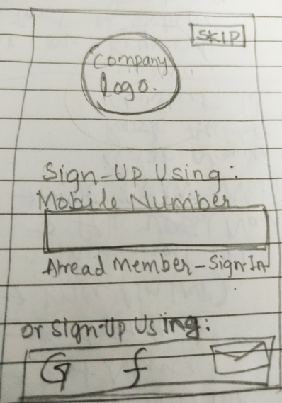
Login Screen
Customer can login using mobile number, or using any social media channel.
If customer wants, they can skip by clicking on ‘SKIP’ button on the top right.
Notes:
© Copyright UpGrad Education Pvt. Ltd. All rights reserved

Slide 49
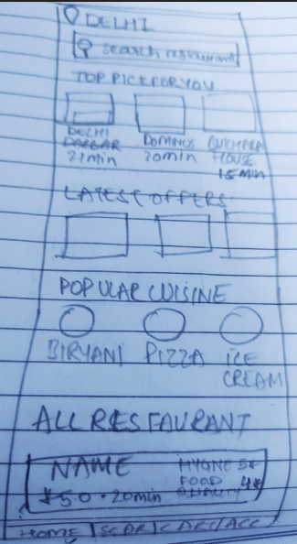
Home Screen
Location is known automatically and all the top restaurants are shown.
4 sub-section are provided:
Home – for coming to home page
Search – for searching restaurant or apply filter
Cart
Profile
Notes:
© Copyright UpGrad Education Pvt. Ltd. All rights reserved

Slide 50
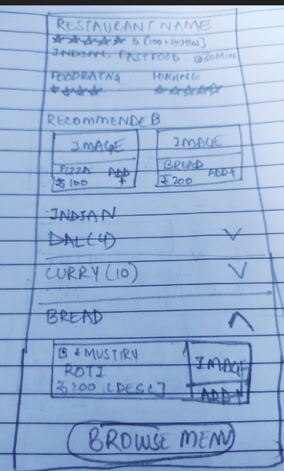
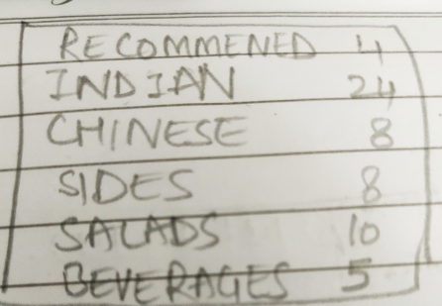
Restaurant Details Screen
Restaurants details along with rating (food, hygiene and overall) are shown.
Recommended are displayed at the top
Clicking on Browse Menu button opens a small menu provided below:
Notes:
© Copyright UpGrad Education Pvt. Ltd. All rights reserved

Slide 51
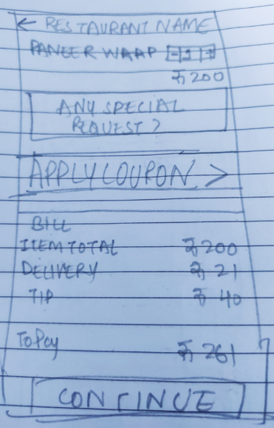
Checkout Page
All the order selected are shown here.
Customer can apply coupons.
Customer can also add any special instructions to restaurants
Notes:
© Copyright UpGrad Education Pvt. Ltd. All rights reserved

Slide 52
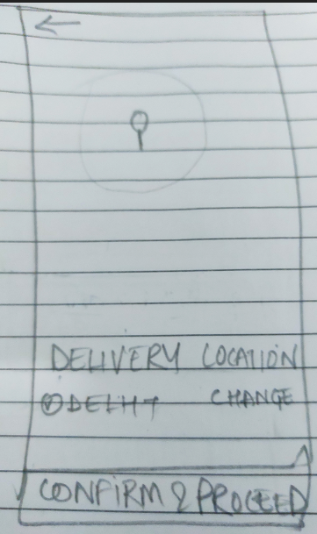
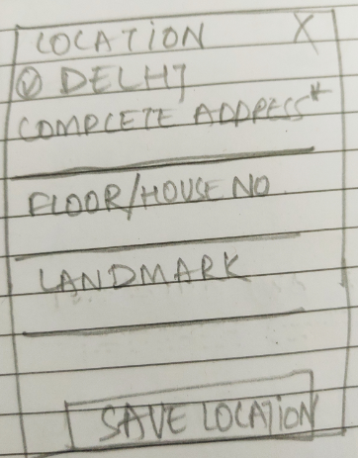
Address Confirmation Page
Address selection by pinning the location on to the map.
Once confirm, can add other details like floor and/or landmark.
Notes:
© Copyright UpGrad Education Pvt. Ltd. All rights reserved

Slide 53
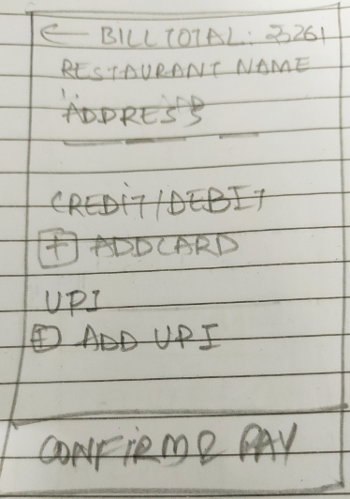
Checkout Page
Various options to pay for orders
Notes:
© Copyright UpGrad Education Pvt. Ltd. All rights reserved

Slide 54
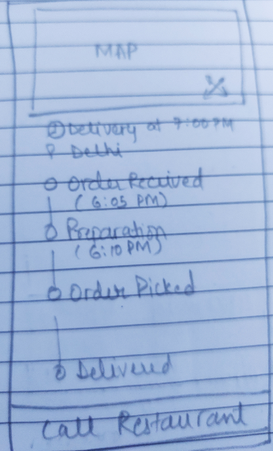
Order Tracking Page
Order tracking based on map view with real time update of the order.
Also track the real time location of the delivery person.
Once order picked, name and phone number of the delivery person will be displayed.
Notes:
© Copyright UpGrad Education Pvt. Ltd. All rights reserved

Slide 55
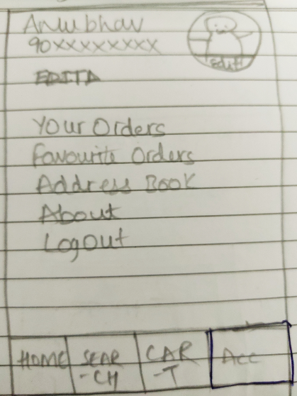
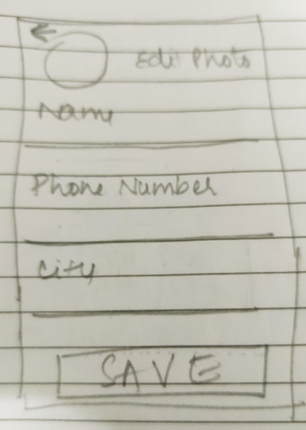
Profile Page
Profile Update page.
Customer can see all the past orders, adreses and if required can update the address.
Customer can edit personal information like photo, name and phone number
Notes:
© Copyright UpGrad Education Pvt. Ltd. All rights reserved

Slide 56
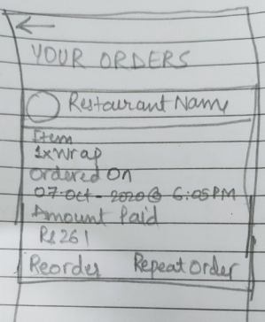
Order Page
Order list page shows all past order and present order.
Notes:
© Copyright UpGrad Education Pvt. Ltd. All rights reserved

Slide 57
Part 7: Wireframing and Prototyping
Notes:
© Copyright UpGrad Education Pvt. Ltd. All rights reserved

Slide 58
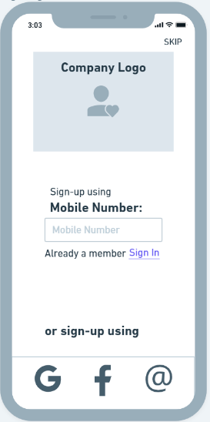
Login page
Notes:
© Copyright UpGrad Education Pvt. Ltd. All rights reserved

Slide 59
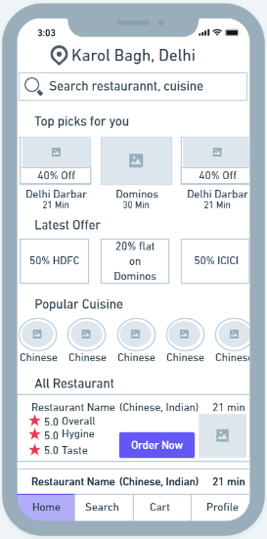
Home page
Notes:
© Copyright UpGrad Education Pvt. Ltd. All rights reserved

Slide 60
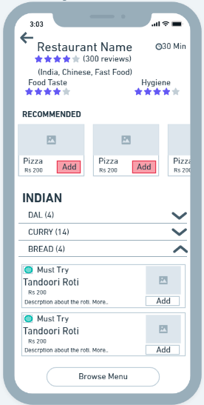
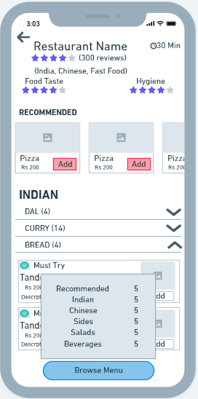
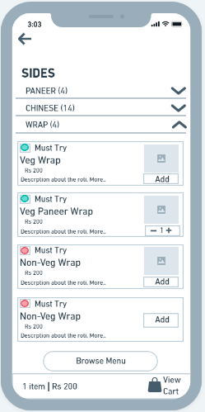
Restaurant page
Notes:
© Copyright UpGrad Education Pvt. Ltd. All rights reserved

Slide 61
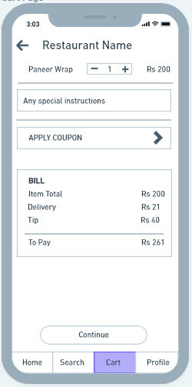
Cart page
Notes:
© Copyright UpGrad Education Pvt. Ltd. All rights reserved

Slide 62
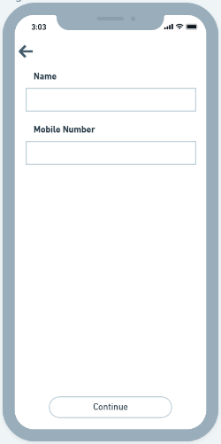
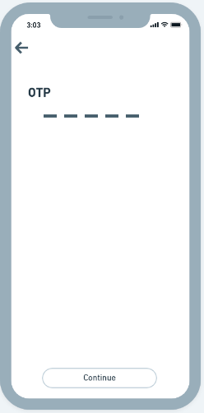
Registration for guest user page
Notes:
© Copyright UpGrad Education Pvt. Ltd. All rights reserved

Slide 63
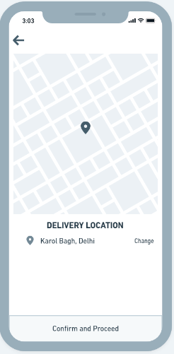
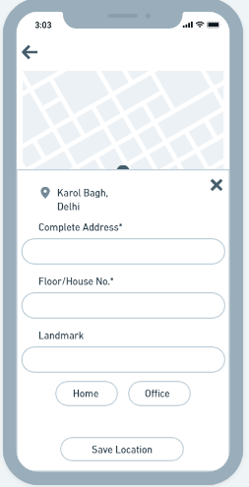
New Address Selection
Notes:
© Copyright UpGrad Education Pvt. Ltd. All rights reserved

Slide 64
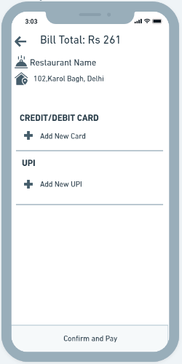
Payment Page
Notes:
© Copyright UpGrad Education Pvt. Ltd. All rights reserved

Slide 65
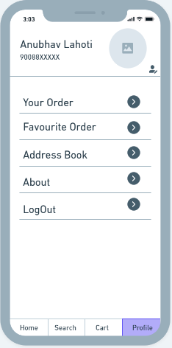
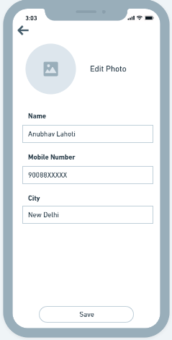
Profile Page
Notes:
© Copyright UpGrad Education Pvt. Ltd. All rights reserved

Slide 66
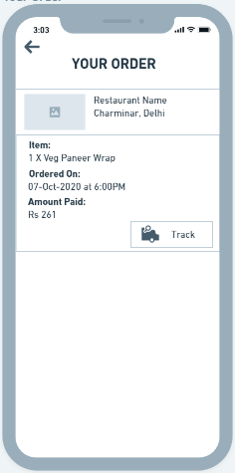
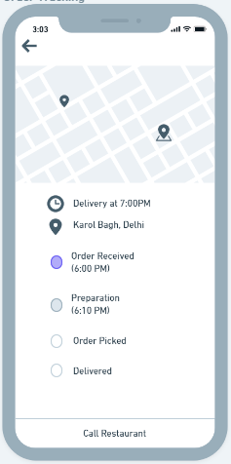
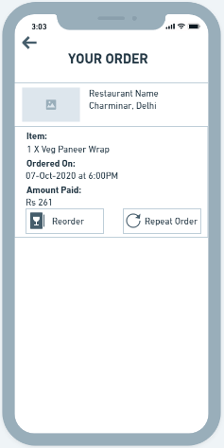
Order Page
Notes:
© Copyright UpGrad Education Pvt. Ltd. All rights reserved

Slide 67
Login Navigational Flow
Notes:
© Copyright UpGrad Education Pvt. Ltd. All rights reserved

Slide 68
Restaurant Navigational Flow
Notes:
© Copyright UpGrad Education Pvt. Ltd. All rights reserved

Slide 69
Order Flow
Notes:
© Copyright UpGrad Education Pvt. Ltd. All rights reserved

Slide 70
Order Flow Continues..
Notes:
© Copyright UpGrad Education Pvt. Ltd. All rights reserved

Slide 71
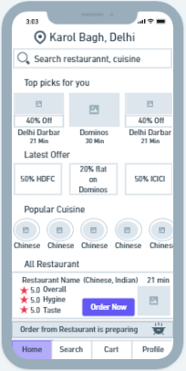
Order Tracking
Notes:
© Copyright UpGrad Education Pvt. Ltd. All rights reserved

Slide 72
Tools used
Wireframing | Whimsical
Prototyping | Marvel
Notes:
© Copyright UpGrad Education Pvt. Ltd. All rights reserved

Slide 73
Prototyping
Prototyping | https://marvelapp.com/prototype/93ihb7d
Notes:
© Copyright UpGrad Education Pvt. Ltd. All rights reserved

Slide 74
Disclaimer: All content and material on the UpGrad website is copyrighted material, either belonging to UpGrad or its bonafide contributors and is purely for the dissemination of education. You are permitted to access print and download extracts from this site purely for your own education only and on the following basis:
You can download this document from the website for self-use only.
Any copies of this document, in part or full, saved to disc or to any other storage medium may only be used for subsequent, self-viewing purposes or to print an individual extract or copy for non-commercial personal use only.
Any further dissemination, distribution, reproduction, copying of the content of the document herein or the uploading thereof on other websites or use of content for any other commercial/unauthorized purposes in any way which could infringe the intellectual property rights of UpGrad or its contributors, is strictly prohibited.
No graphics, images or photographs from any accompanying text in this document will be used separately for unauthorised purposes.
No material in this document will be modified, adapted or altered in any way.
No part of this document or UpGrad content may be reproduced or stored in any other web site or included in any public or private electronic retrieval system or service without UpGrad’s prior written permission.
Any rights not expressly granted in these terms are reserved.

